Slide 1
USS Update and Employer Proposal
6 September 2019
Nicola Arnold, Director of Finance
Cara Wright, Payroll & Pensions Manager

Slide 2
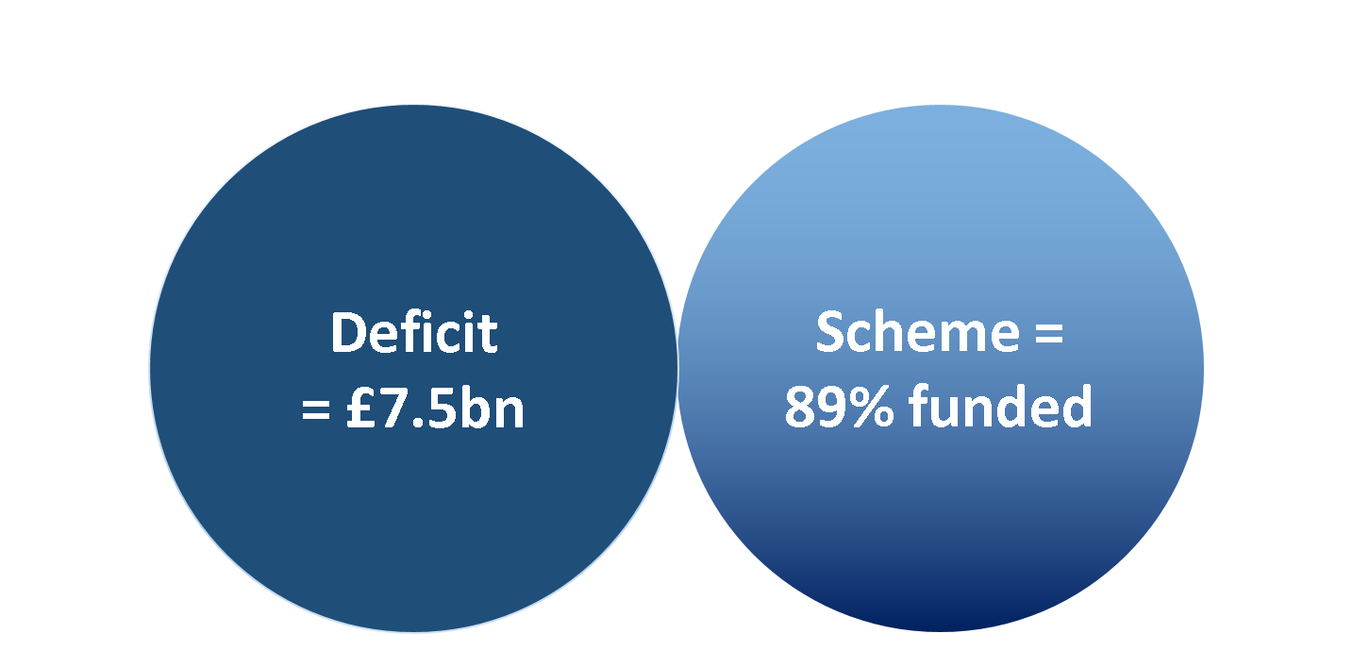
2017 Valuation
Notes:
This was the position of the 2017 valuation when it was finalised in June 2018. This was before Joint expert panel (JEP) reported and challenged the assumptions which underlay this valuation.

Slide 3
Final 2017 valuation contribution rates
Notes:
The backstop position is based on a final total contribution of 36.6% by April 2020 (7 months away) with the increases from the initial 8.0%/18% being split 35%/65% between the employee and the employer. That split was agreed by the JNC (UUK and UCU) as part of the negotiations which finalised the 2014 valuation.
These were the employee rates proposed by that valuation and which remain as the “backstop” position should nothing be agreed as part 2018 valuation
The April 2019 increases have been implemented, and potentially we have another increase in contributions in October 2019 to 10.4% if agreement can’t be reached by UUK and UCU and the latest proposals can’t be accepted by USS.

Slide 4
Employee contributions proposed to date by USS
Notes:
After JEP, it was agreed between USS, UUK and UCU to look at some of the JEP recommendations and revalue the scheme as at March 2018 in order to retain benefits but at a lower cost which JEP believed was possible without putting the scheme under too higher risk.
We’re going to take you through the options USS have come up with over the last 9 months as part of these discussions – looking at employee contribution rates (which we assume is what you are all really interested in!)
It’s worth noting that the deficit at this point had reduced to £3.5bn.
The first option was an upper book end limit of 10.7% compared to 11.7% - this was a lower overall contribution than 2017 valuation, but still higher than JEP were suggesting – this was option 1

Slide 5
Employee contributions proposed to date by USS
Notes:
We will quickly talk about contingent contributions – these would be increases in rate, in the cost sharing ratio of 35/65, should the valuation of the fund fall to a certain level. USS were suggesting that this scenario had a high probability of happening, other experts don’t necessarily agree.
So, assuming all is well, the next option started, and would continue at 9.3% from October 2019

Slide 6
Employee contributions proposed to date by USS
Notes:
However, if the value of the fund fell, both employees and employers would have to start paying contingent contributions increasing from 9.3% to 11.4% (the same rate as the 2017 valuation)

Slide 7
Employee contributions proposed to date by USS
Notes:
The final option, which UUK have submitted to the latest round of JNC meetings, has an increase to 9.6% from October 2019 (so lower than the 10.4% in the 2017 valuation), with the scheme being revalued after two years, rather than 3, in 2020. This would give time for JEP2 to report and give all parties time to properly look and evaluate their proposals. It normally takes 12-15 months for the valuation to be agreed, so all things being equal, and the scheme vale/deficit remains at the current level, this would be an increase to 11% in October 2021.
Of course, it would be hoped that JEP 2 would come up with proposals which if put in place would reduce this.

Slide 8
Employer contributions proposed to date by USS
Notes:
Under the cost sharing arrangements, the employer contributions would also increase.

Slide 9
Current proposed position
Notes:
This last option is the one which is currently being discussed at the JNC. To remind you, the backstop is the 2017 position which would be an increase in October 2019 and April 2020

Slide 10
Current proposed position
Notes:
Option 3, would be an increase of 9.6% from October 2019, with a revaluation as at March 2020 and any changes from that would be effective from October 2021.
If option 3 is not agreed, the next formal valuation wouldn’t be due until March 2021

Slide 11
UUK offer to UCU
Notes:
During the course of negotiations on the 2018 valuation, UUK’s representatives offered to pay an additional 0.5% for two years in return for no industrial action or ballots in relation to USS for the period to October 2021 – subject to consultation. This would have resulted in a lower member contribution rate of 9.1% – exactly aligned with what was proposed by the Joint Expert Panel in its first report, which UCU and UUK supported.
The committee eventually decided – through a casting vote by the independent chair – to conclude the valuation in line with UUK’s original proposal with the cost of increases shared 65:35, resulting in a rate of 21.1% of salary for employers, and 9.6% for members

Slide 12
So what does this mean when I get paid?
Spine Point | Salary inc LW | 01/10/2019 9.6% | 01/10/2021 11%
26 | £33,193 | £-15.05 | £-26.33
31 | £37,951 | £-17.20 | £-30.11
35 | £42,299 | £-19.18 | £-33.56
40 | £48,508 | £-21.99 | £-38.48
49 | £62,282 | £-24.08 | £-42.14
60 | £94,942 | £-32.84 | £-57.48
Notes:
As things currently stand, taking Option 3 as the agreed position, in October 2019, your monthly take pay home will be lower by these amounts – this is just a sample, we’ll put the full spine point list on the portal/new website. Then, in October 2021, assuming the March 2020 valuation shows no changes from the current position, there will be a further increase to 11%
That said, we won’t get these confirmed until 11th September and it may be that we have to go back to the 2017 valuation which would be an increase to 10.4% in October and 11.4% In April

Slide 13
So what does this mean when I get paid?
Spine Point | Salary inc LW | 01/10/2019 10.4% | 01/04/2020 11.4%
26 | £33,193 | £-30.09 | £-18.81
31 | £37,951 | £-34.41 | £-21.51
35 | £42,299 | £-38.35 | £-23.97
40 | £48,508 | £-43.98 | £-27.49
49 | £62,282 | £-48.16 | £-30.10
60 | £94,942 | £-65.69 | £-41.06

Slide 14
Joint Expert Panel 2?
Notes:
However, we still have JEP 2 to meet and propose before March 2020 and all bets are off the table by then…..

