Slide 1
USS Valuation 2020/Consultation and Employer Proposal
13 December 2021
Cara Wright, Payroll & Pensions Manager
Susan McPheat, Director of Finance
Jenny Winters, Director of HR&OD
Notes:
Welcome
Housekeeping – cameras and mic’s off, add questions in the chat which we will answer at the end

Slide 2
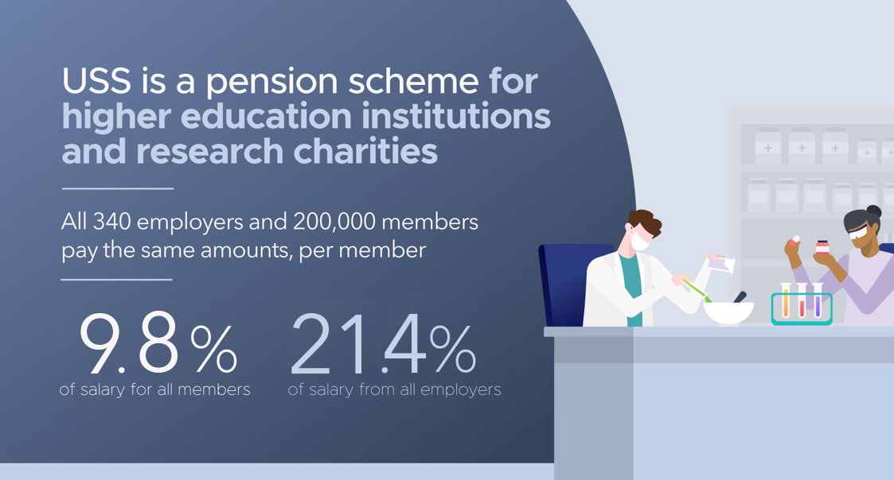
Notes:
USS is the main pension scheme for university staff and the largest private pension scheme in the country. There are 340 scheme employers and 200,000 active members.
A pension is a great way to save for your future. USS pensions are funded by money taken from the salaries of members and payments made by employers.
All scheme members currently contribute 9.8% of their salary (before tax).
All employers pay in 21.4% of salary for each employee within the scheme - whether the employer is a large university or one of the smaller research based charities, which form part of the scheme.
USS offers a mix of defined benefit (DB) and defined contribution (DC) pensions.

Slide 3
USS offers DB and DC pensions-
What’s the difference?
Defined benefit (DB) pensions Members are promised a set amount of pension benefits, based on their salary and length of service, which are (broadly) inflation-proofed.
Defined contribution (DC) pensions Members are not promised a set amount of pension benefits. The total amount of benefits members receive will depend on how much they and their employers contribute, the level of charges applied, and how well the pension scheme's investments perform in the global money markets.
USS currently offers DB pensions for all up to the salary of £59,883.65 and DC pensions on salary above this. This gives members the best of both worlds.
DB benefits provide certainty whereas DC benefits provide flexibility and more choice.
Notes:
A DB pension offers a set amount of benefits based on how long you’re a member and your salary
With DC pensions member and employer contributions are both invested and the proceeds used to buy a pension and/or other benefits on retirement.
Everyone in USS currently gets a defined benefit pension up to the salary threshold of £59,883.65 with salary above this on a defined contribution basis.
DB benefits provide certainty whereas DC offers better choice and flexibility for members. As a member, you can choose to pay in higher or lower amounts depending on your own stage of life, and financial circumstances.
You can access and use your pension pot in any way you wish from age 55. DC pensions are also easier to take with you when you move to a different employer. You also have choice over how your money is invested, which is increasingly important to many people who want to know that industries and companies with strong ethics benefit from their money.
So through the mix of DC and DB pensions, USS members have certainty, flexibility and choice.

Slide 4
Employee and Employer DB/DC Rates
Notes:
This slide shows the amount of employee and employer contributions go into the DB and Dc scheme. The employer contributions cover a larger part of the DB deficit and pay for admin and investment costs

Slide 5
Why join USS?
USS offers a secure monthly payment in retirement for the rest of your life.
You also get a tax-free lump sum on retirement (x3 annual pension)
Pension payments to your partner and children if you die before retiring (x3 annual income as lump sum and pension for life to your spouse or civil partner) or
Lump sum x 3 annual income – in accordance with your death in service nomination
Notes:
USS offers a secure monthly payment in retirement for the rest of your life. It could help towards paying off your mortgage, planning getaways and get you the standard of living you’d like.
That’s why the opt-out rate of around 20% across the sector – members of staff deciding not to be part of the scheme – is concerning. Even if opting-out is a temporary measure, it can have negative consequences for people later in life.
You may receive the State Pension when you retire, but it might not be enough. Putting some income now into a pension scheme means you’ll have a bigger income in the future. Plus, your employer will be contributing too – making up a big chunk of your pension.
You get tax relief on your contributions and there’s life cover of three-times your annual salary to look after your loved ones in case you die while paying into the scheme.
With the DC part of the scheme, members can make additional voluntary contributions and transfer money in – tax efficient ways of saving on top of the hugely valuable employer contributions.
Staff should keep in mind the importance of joining a pension scheme, continuing to save, and benefit from the contributions employers make. This is especially important during difficult times when members may be more tempted to withdraw from the scheme.

Slide 6
What is a valuation?
A valuation is an assessment of a pension scheme’s financial health.
It is a legal requirement for all defined benefit (DB) pension schemes to carry out a valuation at least once every three years.
USS estimates that the current deficit is as high as £17 billion.
When a scheme has a deficit, additional contributions are needed to get the funding back on track or the benefits on offer need to change.
Notes:
A valuation provides a snapshot at a point in time, to show whether a scheme is expected to have enough money to pay the benefits already promised to members. It also shows whether the combined member and employer contribution rate will be sufficient to fund the level of benefits currently provided to members.
The 2020 USS valuation is based on a snapshot of the scheme’s funding position on 31 March 2020, but the process itself will run well into 2021, as there’s a number of different steps.
A deficit means additional contributions will be needed to get the funding back on track or the benefits on offer need to change. USS estimates that the current deficit is as high as £17 billion – that kind of money would be sufficient to pay for the hosting of the London 2021 Olympics, twice. The deficit is on past service and must be paid for by future contributions, members and employers. The % of contributions taken for the deficit currently equates to 6.3%
If UCU, representing scheme members, and UUK representing employers, don’t reach an agreement on increased contributions, it would be necessary to consider reducing future benefits to make the scheme affordable.
Members’ pensions built up before the valuation date are protected by law and won’t be affected by any changes.

Slide 7
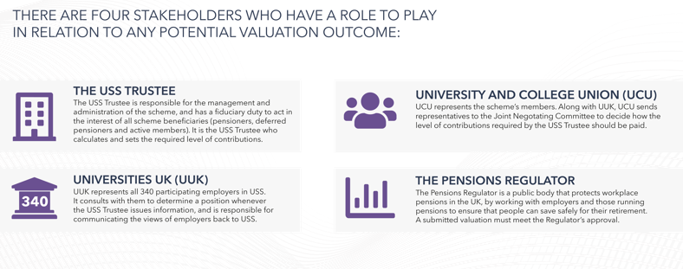
USS VALUATION: Who does what?
Notes:
There are four main stakeholders involved in the valuation:
The USS Trustee has legal responsibility for the running of the scheme and ensuring that pension promises are paid as they should be.
UUK represents all 340 employers in the scheme.
UCU represents all scheme members, even those who aren’t members of UCU.
The Pensions Regulator is the public body responsible for regulating workplace pensions in the UK. All valuations must be submitted to the Regulator for approval, to satisfy it that the scheme is on a secure and sustainable footing.

Slide 8
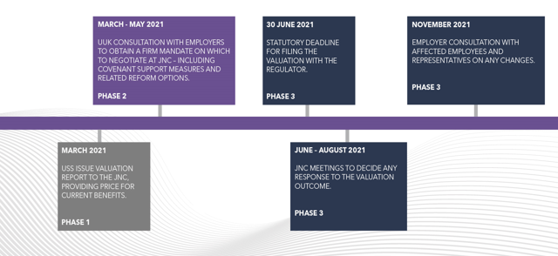
2020 VALUATION: TIMELINE
Notes:
So what’s the current state of play with the valuation?
In March 2021, the USS Trustee published a series of prices for providing the current benefits – based upon different views of covenant support (the financial strength of employers sponsoring the scheme and their commitment to the scheme).
During April and May, UUK consulted all employers on the issued raised, and as part of that many employers sought the views of all their staff eligible for USS. Over the summer, discussions have taken place between UUK, UCU and USS at the JNC. The JNC is made up of an equal number of representatives from UUK and member representatives from the University and College Union (UCU). It has an independent Chair. The JNC decides how any increase to the overall contribution rate should be shared between members and employers and whether any changes should be made to benefits or the structure of the scheme.
On 26 August 2021, the JNC made a decision to support a Universities UK proposal to change the benefits – but keep contributions close to current levels. There is now an important and open consultation with scheme members, which started in November and is running until 17 January 2022, and it is possible that the UUK proposal could change following this to reflect the priorities of members providing it doesn’t lead to higher contribution rates for members or employers.
Now lets look at the USS pricing and the UUK proposal in more detail.

Slide 9
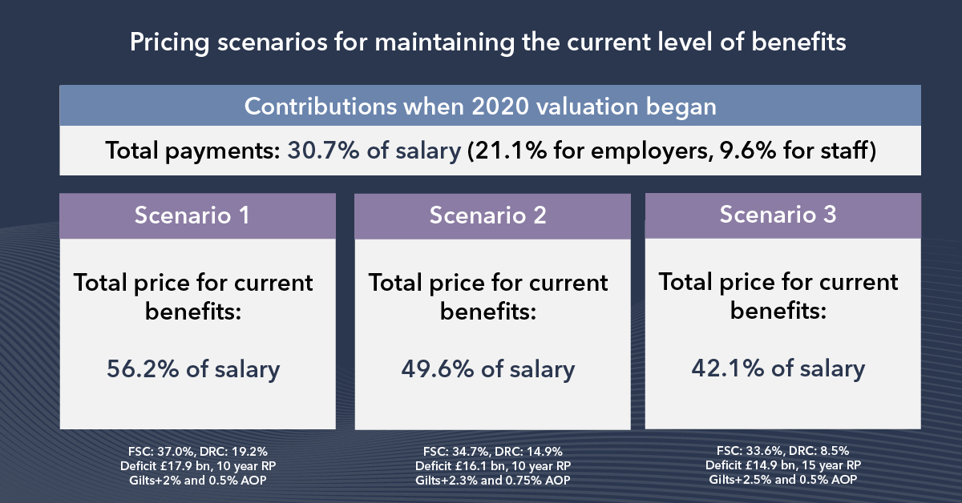
Notes:
In its announcement at the start of March 2021, the USS Trustee said it calculated the pension scheme faced a deficit of up to £17bn and that contributions to the scheme would need to increase from 30.7% (total current contributions for employers and employees) to at least 42.1% of salary to maintain the current level of benefits. This is the lowest price to keep benefits the same – 42.1% of salary – which is unaffordable for employers and members alike and made changes to the scheme inevitable. In the pricing put forward by USS there were three scenarios, which depended on the outcome of discussions about covenant support – the financial backing and commitment of employers to the scheme.
In response, employers said the very high prices for current benefits put forward by the USS Trustee would be unaffordable for employers, risked pricing even more staff out of the scheme, and undervalued the collective and enduring financial strength of the participating employers. UUK, on behalf of employers, continues to probe the USS Trustee about its approach to the valuation and is questioning the role of The Pensions Regulator. You can see copies of their letters to the Pensions Regulator and the USS Trustee on the USS Employers website.
Employers (via UUK) pushed the USS Trustee to consider a revised approach and assumptions to bring down the headline costs down and ensure that reform is proportionate, justified, and in the best interests of the scheme members.​

Slide 10
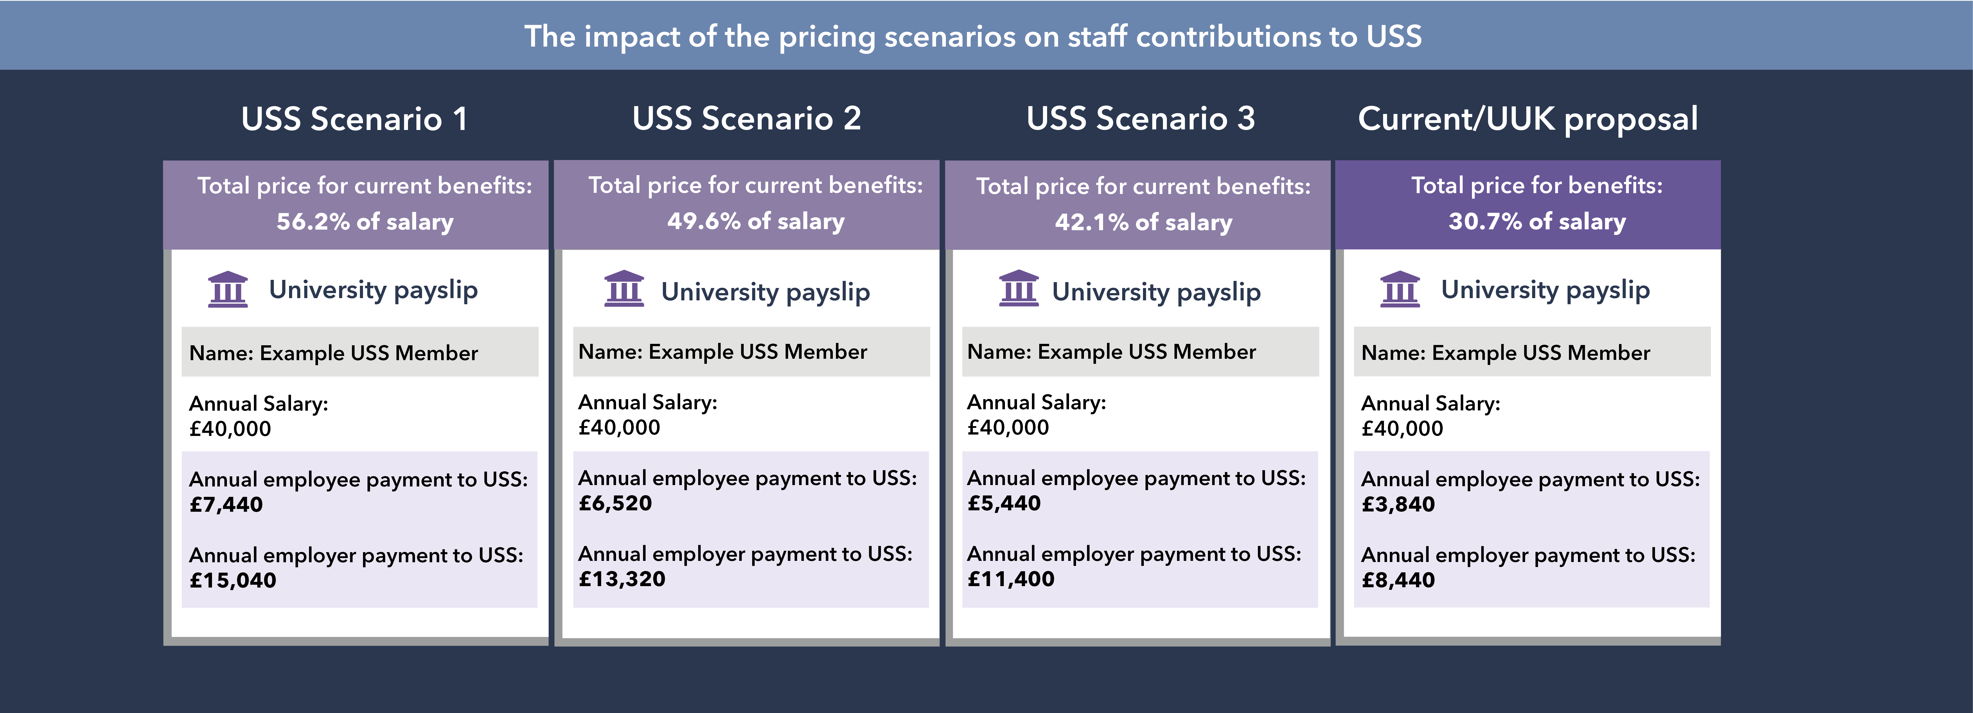
Notes:
This shows how the various scenarios from the USS Trustee and a proposal from Universities UK would impact you, scheme members (contribution payments featured assume the scheme’s default cost-share arrangements – the split of costs between members and employers – are applied. The ratio is 65% for employers, 35% for members). The proposed level of contributions required are unrealistic and would be completely unaffordable for both members and employers.
Even under Scenario 3 – with an employer commitment to significant covenant support measures – members and employers would be required to pay unacceptably high levels for the SAME benefits.
It is also possible that USS may impose these levels of contributions, which, even if for only a short time, we anticipate would lead to even more people dropping out of the scheme and missing out on savings for their pensions.
NB: The UUK proposal will result in a reduction in future benefits of between 10-18% for most members (7 – 15% including state pension. But without change a typical scheme member could ultimately face a cut in their take home pay of approximately £1,600 a year in increased contributions, but the default of the contribution increases for members and employers is even more scary.

Slide 11
October 2021 Rates
Notes:
On 3 September 2021 the USS Trustee board agreed to take forward the Joint Negotiating Committee’s (JNC) recommendations for concluding the 2020 USS valuation, saving university employers and hundreds of thousands of scheme members from steep contribution increases from 1 October 2021. With the USS Trustee board’s approval of the JNC’s decision to modify benefits, they intend to introduce a total contribution rate of 31.2%, with the 0.5% increase split 65:35, leading to an increase of 21.4% for employers and 9.8% for members. The valuation outcome is subject to consultation with both employers and members.

Slide 12
Employers’ objectives
A valuable pension scheme for staff including a defined benefit element.
Fair valuation assumptions, leading to fair pricing by the USS Trustee.
Affordable contributions levels for members and employers.
Reducing the number of people priced out of the scheme by introducing an optional low-cost entry route for members.
Notes:
We recognised that the USS Trustee’s options were unpalatable to members and employers, but we agreed with the USS Trustee that the scheme is facing a deficit – a shortfall in funding – which means more money has to go into the scheme or the pension benefits promised in the future would need to be adjusted. Universities UK, which represents employers, set out four objectives as it tried to find a solution.
Firstly, employers recognise that scheme members value the defined benefits part of the scheme and want to retain this, if possible and affordable.
Secondly, Universities UK has kept up the pressure on the USS Trustee to reconsider its approach to the valuation.
Thirdly, Universities UK developed its own proposal, which is based on employers and scheme members’ contributions staying at the same level – 21.1% and 9.6% of salary – or as close to it as possible rather than the much higher totals required under the USS Trustee’s three scenarios.
Finally, employers also want to find ways of making USS appeal more to the generation of university staff being priced out of the scheme and left with no savings towards their pensions.

Slide 13
UUK’s alternative path
Employers agreed to give even more valuable employer support measures to save the defined benefit part of the scheme – valued at around £1.3 billion per annum by the USS Trustee.
Employer support for fully investigating the feasibility of conditional indexation, a major governance review of the scheme, and a new flexible cost option for scheme members.
The scheme’s Joint Negotiating Committee (JNC) decided to adopt a UUK proposal for changes to benefits to tackle the rising costs, and the USS Trustee subsequently agreed to modify its approach to the valuation in line with these recommendations.
The Pensions Regulator is concerned that the UUK proposal could carry too much risk.
Employers would be very willing to consider other feasible and affordable proposals from the UCU.
Notes:
UUK proposed an alternative path to the 2020 valuation, which gained the support of employers through a consultation.
As part of this, employers agreed even more valuable covenant support measures. These commitments are substantial and go beyond the level of support USS has asked for in its scenarios and would allow Defined Benefits to still be offered as part of the DC/DB mix. Without covenant support measures from employers, the USS Trustee has said it would price current benefits at 56% of salary, 80% more than the current contribution rate – and it values this additional level of covenant support at around £1.3 billion per annum.
This level of proposed employer covenant support could limit employers’ ability to borrow money in the future and/or lead to higher borrowing costs, and be a barrier to improving courses, facilities and services to students and staff. It will likely be the financially weaker employers that will be most severely impacted, since they rely on secured borrowing the most and have the thinnest reserves, so increases in cost could feed immediately through to cost-cutting.
The UUK proposal adjusts the balance of benefits between DB and DC so that less guaranteed benefit is provided. Another way of looking at this is acknowledging that we will all have to work a little longer to get the same level of guaranteed pension as before (in a similar manner to the state pension) to reflect that on average we are living a little longer and guaranteed pensions have become much more expensive, but of course, this could be offset by good investment returns and flexibilities provided for those members also contributing to the Defined Contribution part of the scheme.
Employers also gave their support for giving members the choice of opting for a new lower contribution rate for different benefits, a major governance review, and fully developing a potential move to conditional indexation – which pegs a part of annual pension provision to the performance of scheme funds – and consulting with members on this possibility. This may take many months or years to implement so it is not a solution to this valuation.
Following the employer consultation, the USS Trustee agreed to modify its approach to the 2020 valuation in line with many of the points put forward by UUK and outlined in the consultation. The USS Trustee has been willing to adjust its assumptions to lower scheme costs, to offer the level of Defined Benefits for the covenant support proposed by UUK – at close to current contribution levels.
This has reduced the headline costs, proposed by the USS Trustee which will give scheme members a better level of benefits for current contribution levels than possible under the USS Trustee’s original proposal.
On 31 August 2021 the scheme’s Joint Negotiating Committee (JNC), made up of an equal number of representatives from UCU and UUK, with an independent chair, voted to formally adopt the UUK proposal. The USS Trustee accepted this, and confirmed that the 2020 valuation could be concluded with a total contribution rate of 31.2%. UUK will continue to challenge this 0.5% difference, but for the time being it is proposed that it will be split 65:35 between employers and members, resulting in rates of 21.4% and 9.8% of salary respectively.
Employers have consistently said that they would be happy to explore viable alternatives from the University and College Union (UCU) in a spirit of compromise. While the UUK package proposes a particular set of changes to the future pensions earned from USS’s defined benefit and defined contribution sections, the upcoming consultation on the changes is important and open. We will still consider alternative benefit structures and formulations, provided they are viable and implementable.

Slide 14
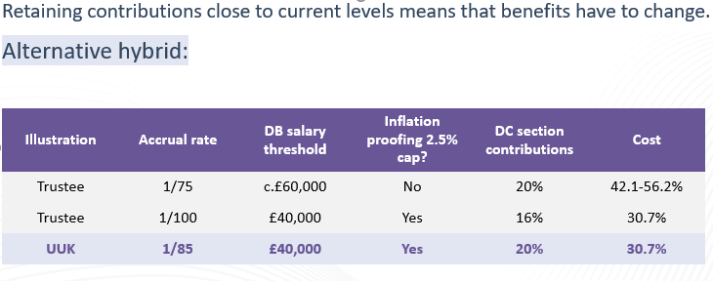
UUK’s alternative path
Notes:
Here we see the alternative UUK proposal in more detail and comparisons to the Trustee’s illustrative examples.
The JNC has now made a decision in favour of the UUK proposal, and the USS Trustee board has agreed to take it forward formally. Consultation is now open and running with employees and their representatives.
There are other variations to the UUK proposal meaning different trade-offs between the salary threshold for Defined Benefits and the accrual rate, for example it may be possible to keep a 1/75th accrual rate if the salary threshold was brought down to £30k. There could also be adjustments to other parts of the benefits package, for example reducing death or ill-health benefits; or changing the pension age.
Remember that pensions built up to date are safe and can’t be changed retrospectively.
Accrual rate: The proportion of salary a member receives annually as a pension in retirement (eg 1/75th) under the defined benefit section of USS.

Slide 15
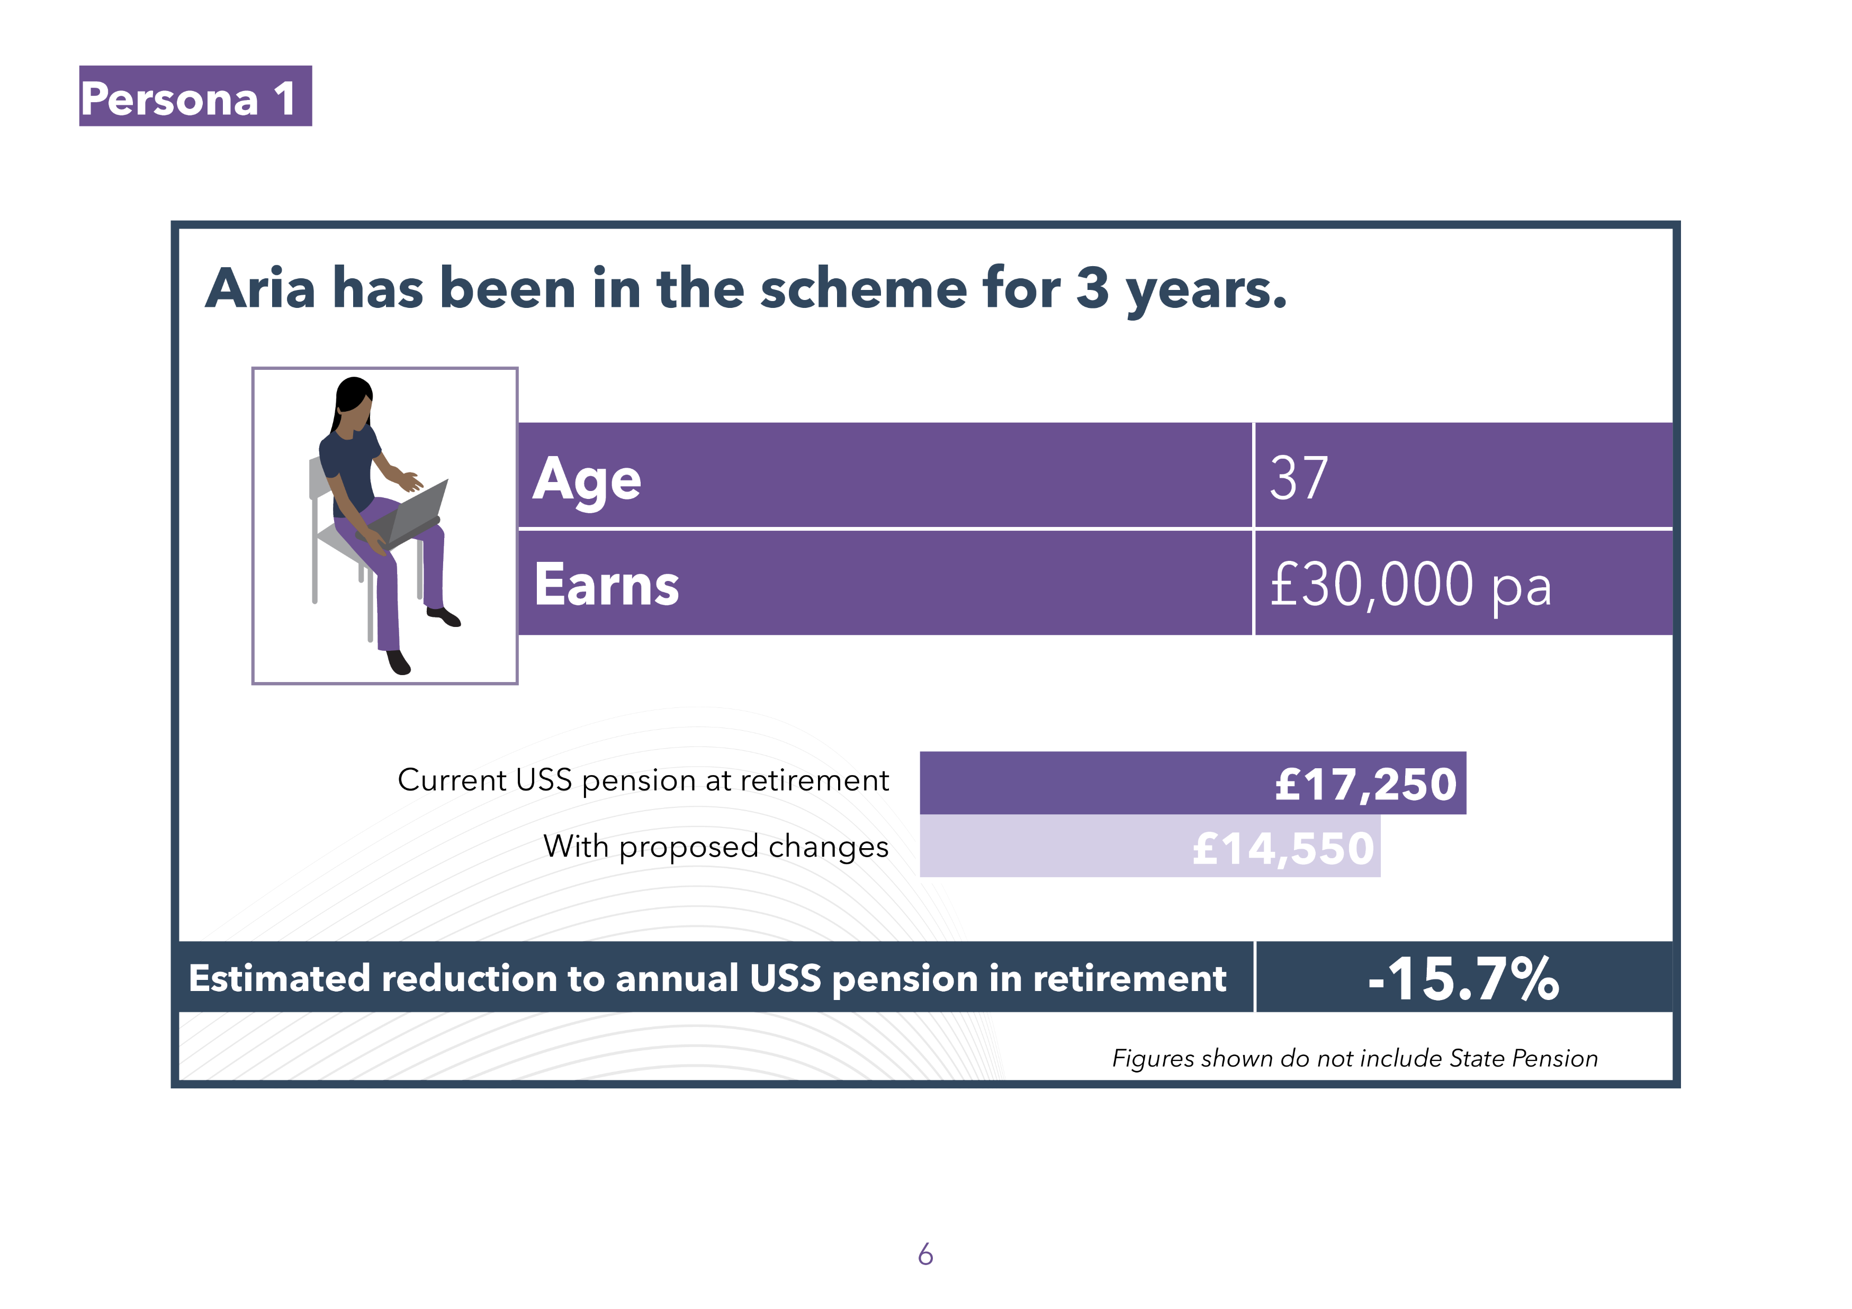
How might benefits change?
Notes:
In November, The USS Trustee via employers commenced a member consultation on the proposed changes. This is a statutory 60 day consultation which will give scheme members an accurate projection of the impact of the changes on them depending on their individual circumstances, including age, projected salary growth, different rates of inflation, amount of years in the scheme, and retirement age. All scheme members are encouraged to use this modeller.
Here are some examples using different service lengths, age and salaries. As the proposed benefits are for future service only, all past service is protected and therefore the closer you are to retirement and the more years of protected service you have will see you less impacted than someone younger or with less service.
They show a reduction in USS pension of between 10% - 18% (7%-15% if a full state pension is factored in) with a retirement age of 66 (current state pension age). All outcomes are at 2021 prices.

Slide 16
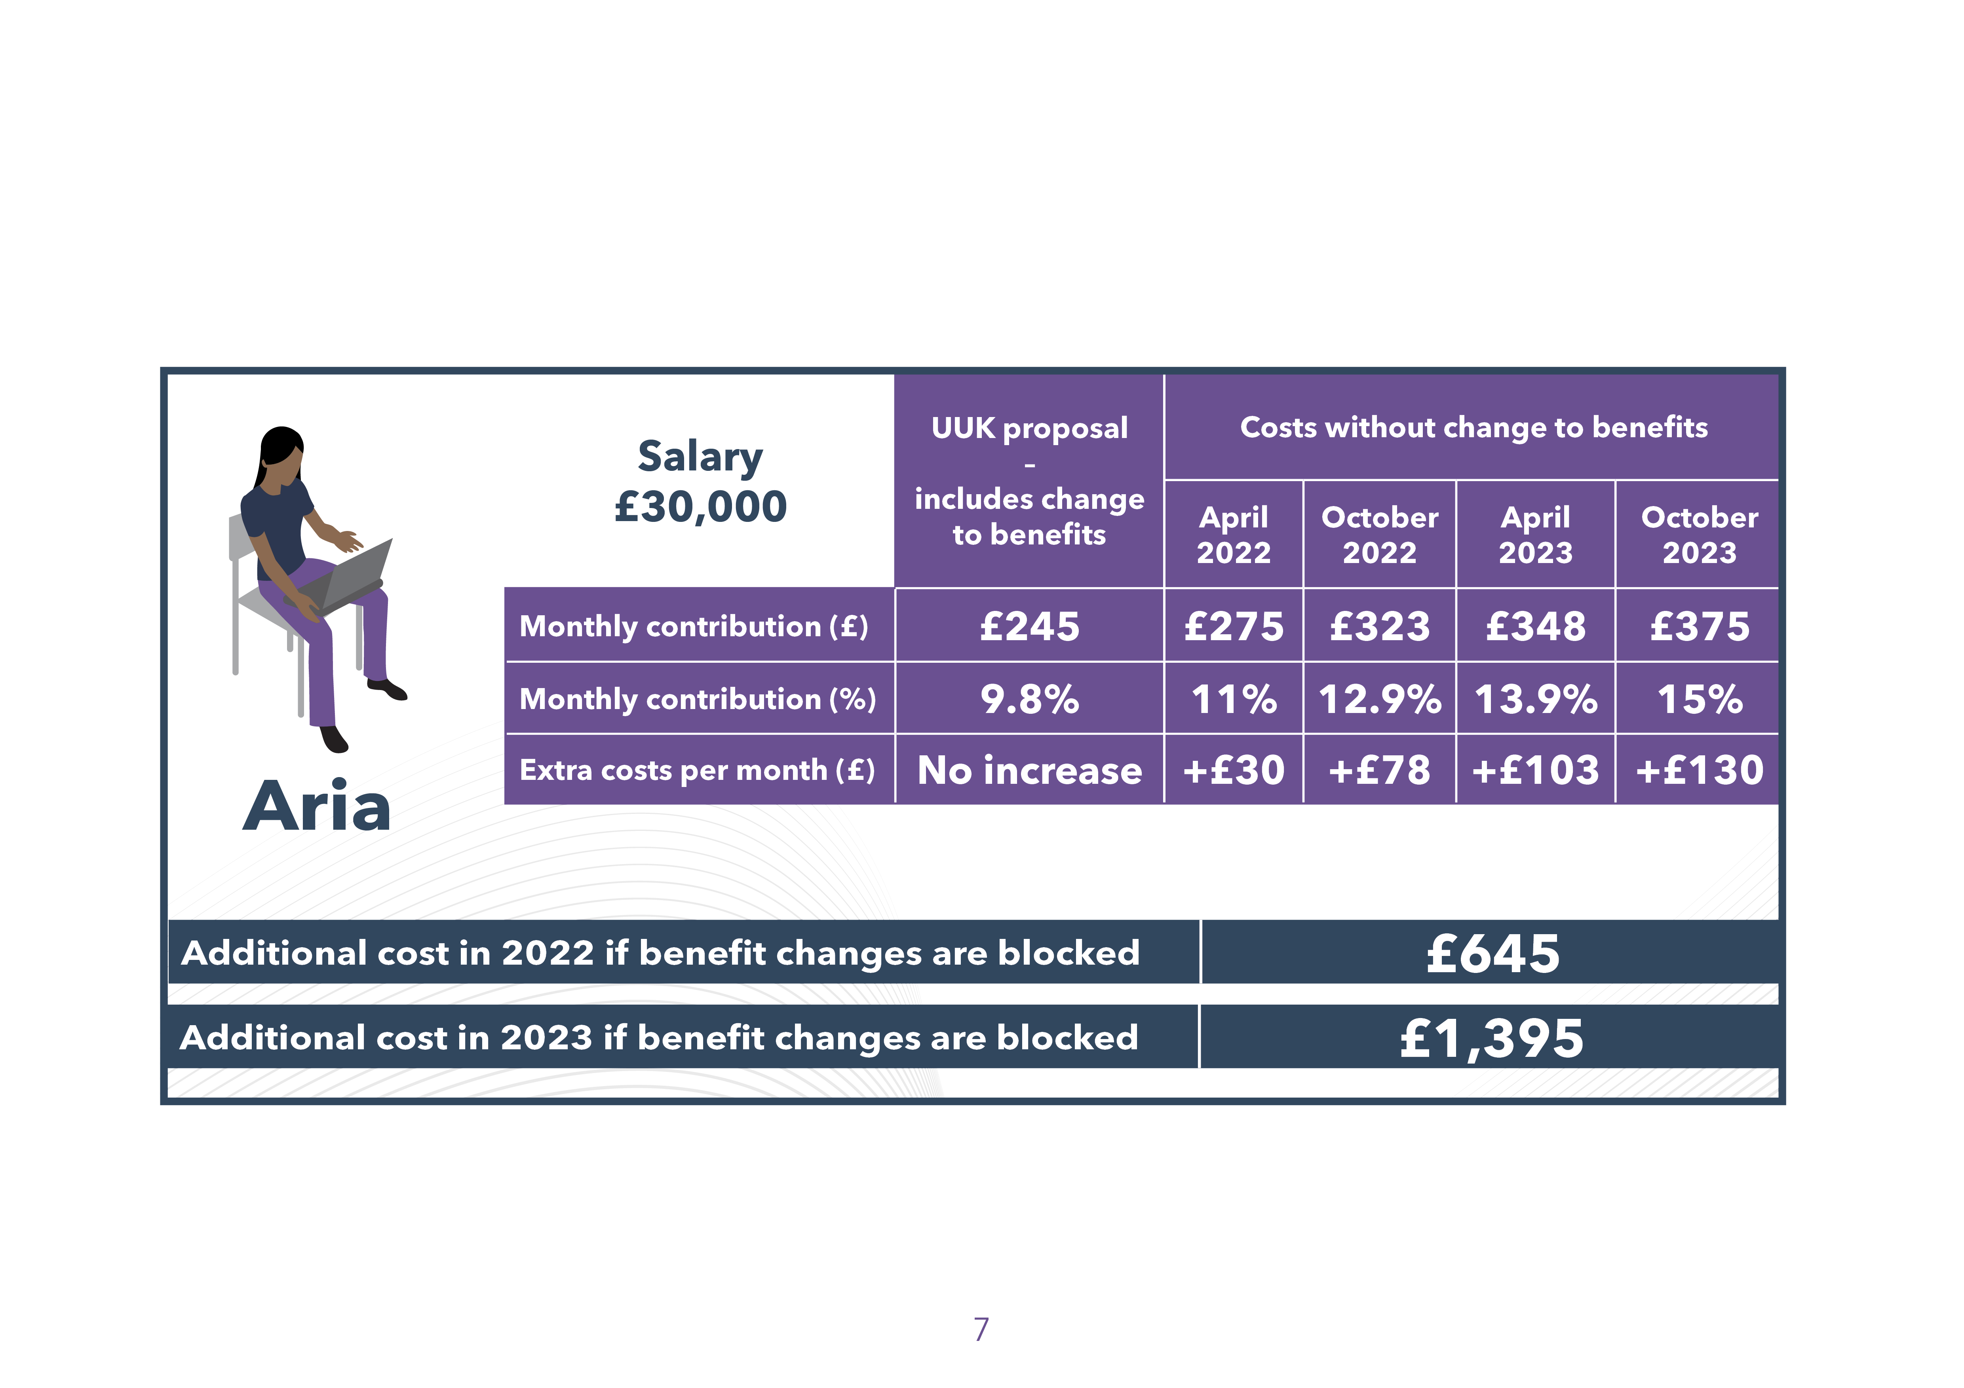
How might benefits change?
All contributions increases do not take tax into account which will differ according to each member’s individual circumstances.
Notes:
So Aria with a salary of £30,000 can expect a reduction of around 15% in her annual pension under the proposals.
However, if there are no changes to the scheme, to keep the same level of pension benefits, on her £30,000 salary Aria would need to pay in £643 more next year, rising to £1,395 more in 2023 and continues to increase, unless changed at the next valuation.

Slide 17
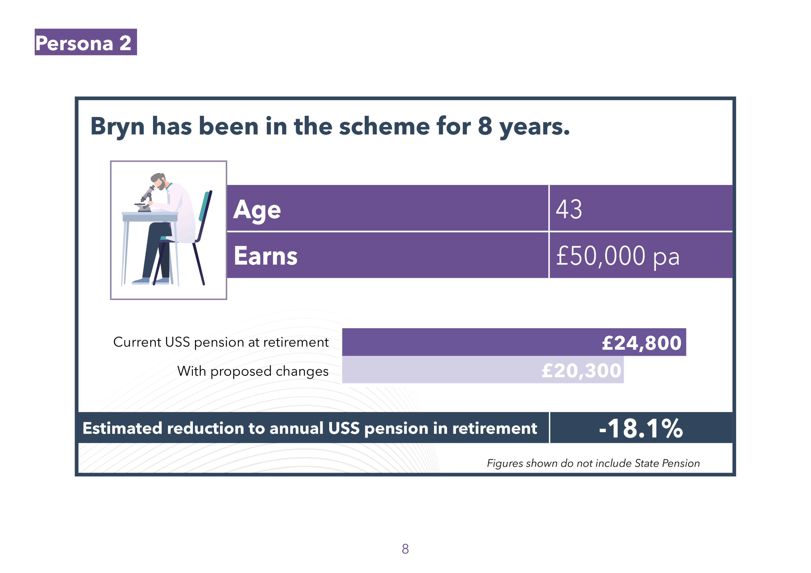
How might benefits change?
Notes:
The USS Trustee estimates this would be the impact on someone earning £50,000 a year. It’s an 18% reduction in their annual pension (excluding state pension or any other retirement savings they may have).

Slide 18
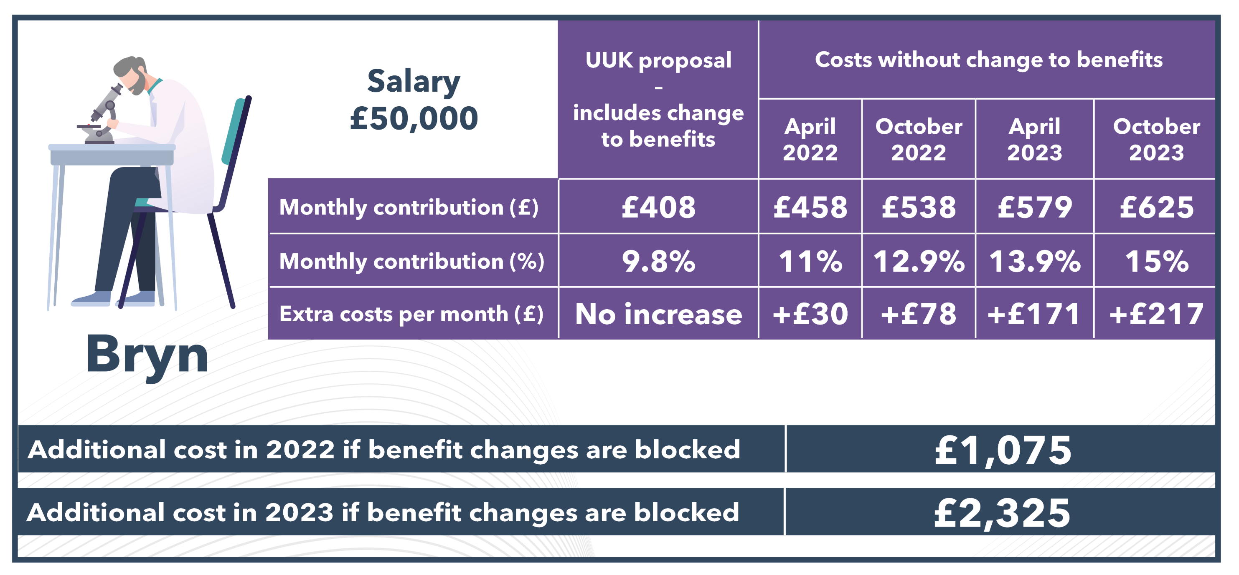
How might benefits change?
All contributions increases do not take tax into account which will differ according to each member’s individual circumstances.
Notes:
The flip side is that it would cost them over £1,000 next year to keep the pension the same, and more than £2,000 in 2023 and continues to increase, unless changed at the next valuation.

Slide 19
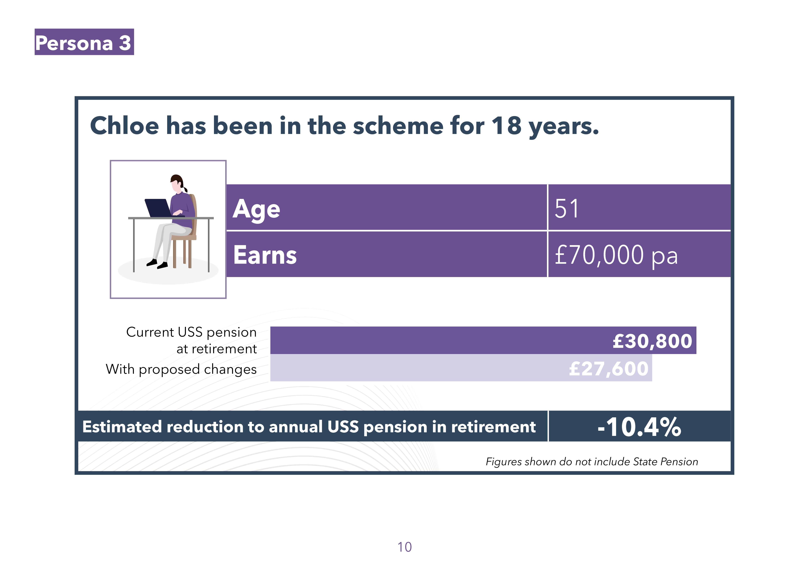
How might benefits change?
Notes:
And this is the project impact on a colleague earning £70,000 – an estimated reduction of 10% in their annual pension

Slide 20

How might benefits change?
All contributions increases do not take tax into account which will differ according to each member’s individual circumstances.
Notes:
But to keep the pension benefits as is – they would be paying in more than £1,500 extra next year, and more than £3,000 extra in 2023 and continues to increase, unless changed at the next valuation.

Slide 21
Retain current benefits - future member rates
Notes:
Without any changes to the scheme, employers and scheme members will have escalating contribution rates imposed on them by the USS Trustee:
Members would see their payments rise from 9.8% of salary, to 11% in April 2022, and even higher in future if changes to the scheme are blocked, similarly escalating every six months until 2025 reaching 18.80%

Slide 22
Retain current benefits - future employer rates
Notes:
for employers, from the current level – 21.4% of salary – to 23.7% in April 2022, escalating every six months until 2025, reaching 38.20%

Slide 23
In summary
USS is a valuable pension scheme.
Long-term challenging environment for pension schemes and real terms fall in income from students. Made worse by financial impact of Covid-19.
USS has set very high prices to maintain current benefits in the 2020 valuation.
UUK proposal – passed by the JNC and accepted by USS – now progresses to an important and open consultation with members.
It retains a significant element of defined benefit within the future pensions earned by members at close to current contribution levels. Pensions built up to date are secure and can’t be changed.
Notes:
In summary,
USS is facing long-term challenges created by rising life expectancy and low interest rates.
Employers and you, scheme members, have had to pay in increasing amounts of money to the scheme in recent years and the USS Trustee says even more money is needed to keep current benefits, at unaffordable levels for employers and scheme members alike.
We want USS to continue to be an excellent pension scheme which rewards and recognises your hard work – but the scheme needs to be sustainable and within the boundaries of the money available.
We know that talking about pension changes is unsettling, especially after the time everyone has had with Coronavirus. We want to reassure you that your USS pensions built up to date are secure and can’t be changed.
The decision by the Joint Negotiating Committee to support the UUK proposal means there is a viable and implementable solution to the 2020 valuation, which sees a significant element of defined benefit retained within the future pensions earned by members at close to current contribution levels.
The UUK proposal is now subject to a full, important and open consultation with you, scheme members, and the UCU, other unions and representative bodies. Please do have your say on the proposal – it could change yet. Employers remain open to considering alternative benefit structures and formulations, provided they are viable, affordable and implementable.

Slide 24
And finally- doing nothing isn’t an option
The USS Trustee board’s decision to proceed with the UUK proposal means these rates have been avoided, but if the employers proposals are withdrawn, the contributions escalator will be enforced.
If enforced, these contribution rises would risk pricing more and more members out of pensions savings, and lead to cuts in teaching, research, and jobs at many institutions as employers would be forced to pay extraordinarily high pension costs and have to find this money from elsewhere in their budgets.
In partnership with the UCU, we look forward to progressing a major governance review of USS, jointly exploring future options for scheme design including Conditional Indexation, and shaping a lower-cost option so staff on lower salaries are no longer priced out of retirement saving.
Notes:
The UUK proposal avoids these escalating and unaffordable contribution increases. The employers have provided more covenant support which has kept the costs down and we will be committed to explore longer-term changes such as the governance review of USS, alternative scheme design including Conditional Indexation, and shaping a lower-cost option so staff are no longer priced out of the scheme.
By USS, UUK and UCU working together, we can make sure that USS remains a valuable, inclusive, and sustainable pension scheme for the future.

Slide 25
Next Steps
Member consultation runs until 17th January 2022
Please have your say via the consultation. All responses are read by us and categorised by USS and will form any alternative proposal put forward to the JNC if required
Use the modeller via the USS consultation which will show information based on individual circumstances, which you can change parts depending on age, etc.
Notes:
Re statement on modeller

Slide 26
Questions ?

