Slide 1

Supporting students who failed a CCA
For Personal Tutors of MBBS students
Dr Laura Yalley-Ogunro
Lecturer in Clinical Communication
Responsible Examiner for F year CCA

Slide 2
Common features that lead to failure?
Reasons for failing vary
Common features (or a combination of):
  Superficial/poor procedural skills
  Deficiencies in knowledge/clinical reasoning
  Poor communication – for example:
    Not listening
    Unstructured/scattergun approach
    Lack of expressed empathy
    Only closed questioning style
    Judgemental language
  Lack of logical presentation and management plan (P + F year)

Slide 3
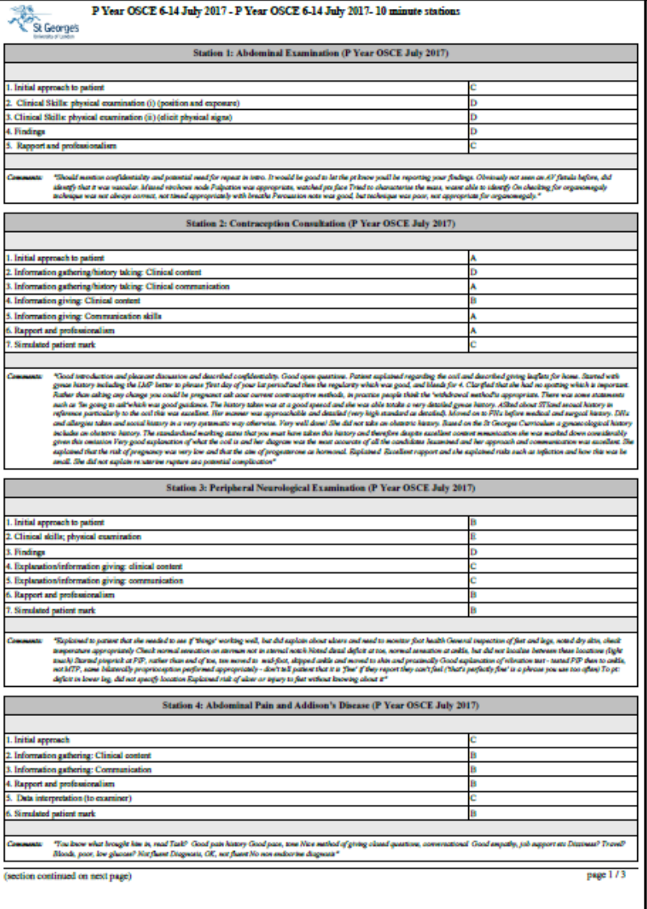
Domain based (T,P,F year)
Checklist (Clinical Sciences)

Slide 4
Suggestions for questions to ask
What do they think went wrong on the day?
What do they think is being assessed in the CCA?
What are their thoughts on the margin by which they failed?
How did they feel during the CCA?
Have they looked at the feedback written on the CCA mark sheet?
How many patients did they clerk each week, whilst on placement?
Are they keeping a clerking book while on placement?
How did they prepare for the CCA?
Who did they practise with?
Did they revisit materials from their clinical and communication skills sessions?
ENCOURAGE STUDENTS TO TAKE UP ALL SUPPORT THAT IS ON OFFER

Slide 5

Support offered
Clinical Sciences CCA (M4Y1 & M5Y2)
  Speak with RE and Personal Tutor
T-year CCA
  Speak with RE, group session with Clinical Communication and Clinical Skills lecturers, and individual follow-up with Communication Skills lecturer
P-year CCA
  Speak with RE, group sessions with Academic support lecturers, individual follow-up with Communication Skills lecturer, mentoring from Clinical Teaching Fellow.
F-year CCA
  Speak with RE, group sessions with Academic support lecturers, individual follow-up with Communication Skills lecturer, mentoring from Clinical Teaching Fellow.

Slide 6
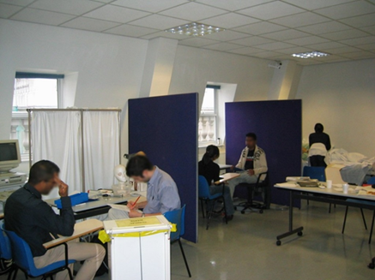
Invitation!
Come and observe a CCA
Any questions?

